Slide 1
Fern Glen Phenology Trail Packet for Volunteers
Program Manager: Vicky Kelly
kellyv@caryinstitute.org
845-677-7600 ext. 174

Slide 2
Welcome
Welcome to the Cary Institute Fern Glen Phenology Monitoring Program. This document contains the steps and protocols to get you set up and on your way toward being a phenomenal phenologist! Monitoring phenology is not hard once you get the hang of it, but attending trainings and field practice is critical to submitting high quality data. Please follow these instructions to get started. Setting up your observer account will only take about 15 minutes, however we recommend spending some time self-training in addition to attending a formal training on the trail before you begin to submit your data. Thank you for your commitment to monitoring phenology!

Slide 3
Getting Started: Set up your account with the USA National Phenology Network (NPN) www.usanpn.org We use the protocols and platform of the USA-NPN. Remember that the field of phenology monitoring is a work in progress and improvements to the NPN website are ongoing. The website has a plethora of wonderful information, incentives and fun stuff. Feel free to peruse the site to learn more about phenology and the work being conducted around the United States and elsewhere.

Slide 4
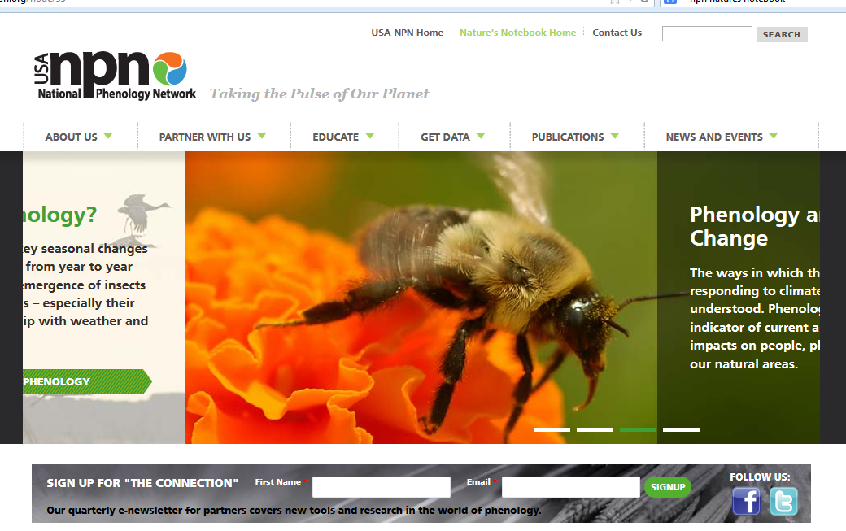
Getting Started, setting up your account Go to www.usanpn.org Click on Nature’s Notebook Home
Notes:
Allows volunteers to easily collect and enter data

Slide 5
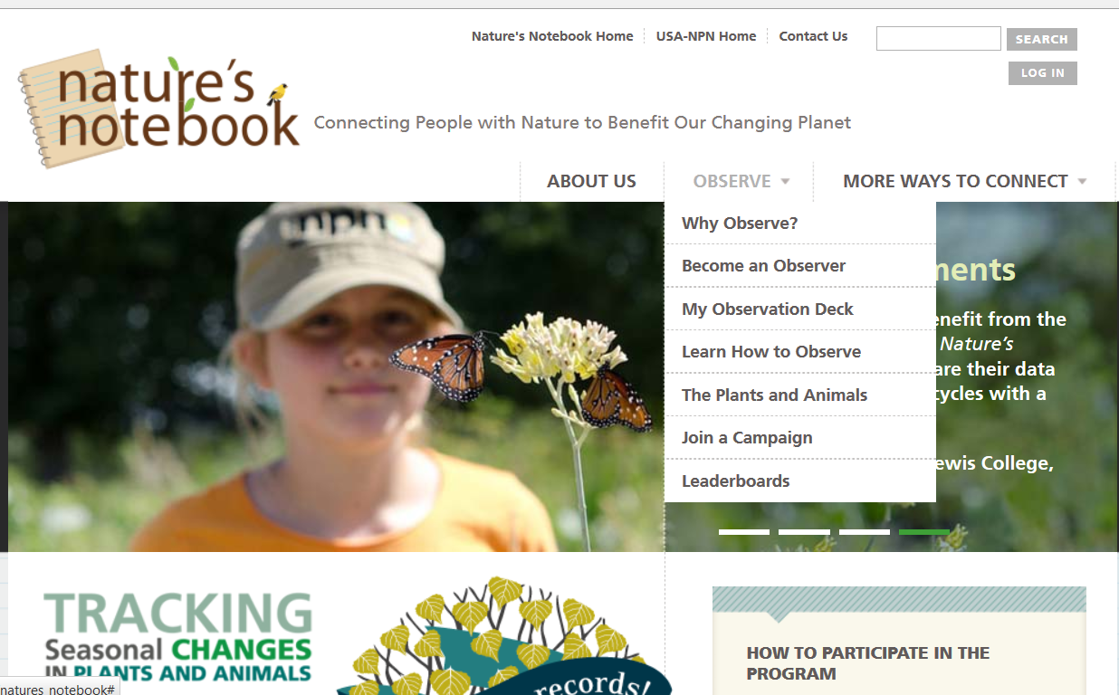
In Nature’s Notebook, click on Observe, Become an Observer Complete registration steps (see next page for step by step instructions)

Slide 6
Step by step instructions for setting up your account
Go to www.usanpn.org and click on Nature’s Notebook home page.
Click on Observe, Become an Observer and set up your account to be an observer. Under the Partner Groups, check New York Phenology Project
When you have registered, go into your observation deck and find “my account details”
Click on the Edit tab
Under Partner Groups, find New York Phenology Project and check Cary Institute of Ecosystem Studies. Be sure that only the box next to the Cary Institute is checked and not NYPP. Make sure you click on save at the bottom. If you think you might collect data at a nearby site such as Vassar College or Mohonk Preserve, you can click on these as well and they will be added to your observation deck.
Click on My Observation Deck now and under Sites, you should see a drop down menu that includes the Cary Institute. Click on this and another drop down menu will appear with two sites, choose Cary Institute Fern Glen. You should see the species list of plants and animals in a drop down menu to the right.

Slide 7
You are now ready to observe. There are two methods of collecting data
Datasheet for later data entry on the NPN website, or
Smartphone app

Slide 8
Printing datasheets
If you prefer to collect data on datasheets for later data entry, you’ll need datasheets to take to the trail with you. Follow these instructions for printing datasheets.

Slide 9
To print datasheets: After you are registered, log on to your observation deck by clicking on My Observation Deck or Log In

Slide 10
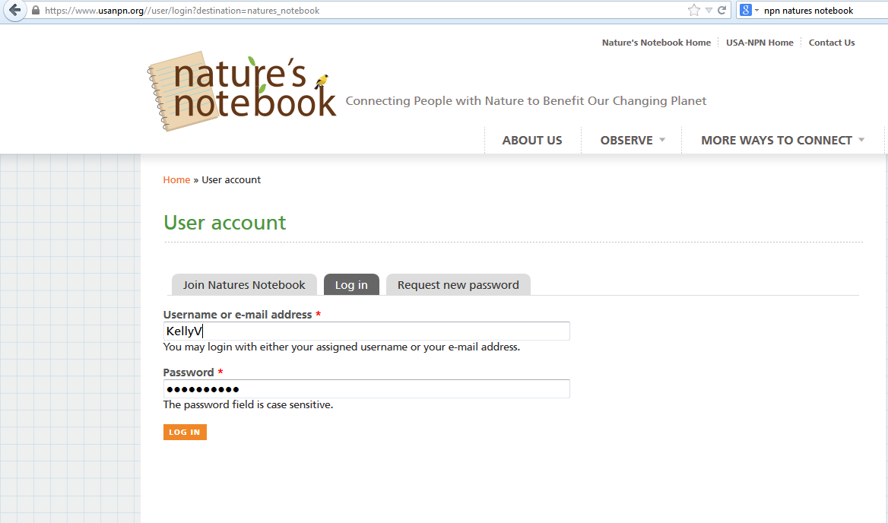
Log in with your username and password

Slide 11
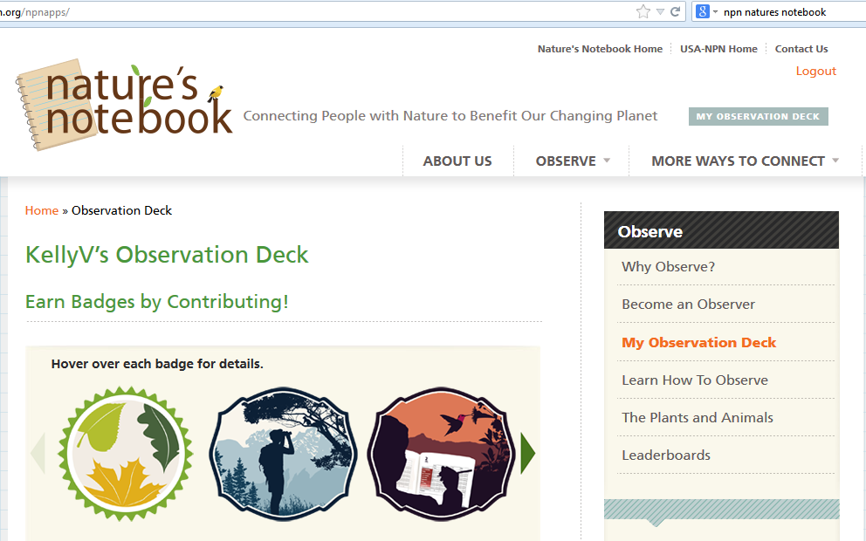
Select My Observation Deck

Slide 12
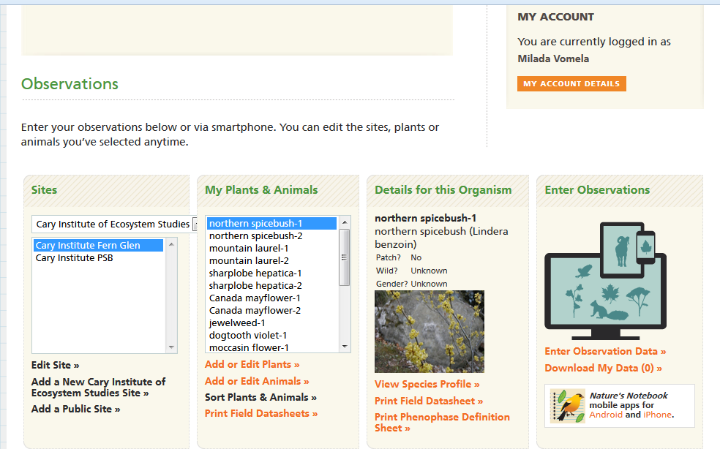
To Print datasheets,
Select Cary Institute Fern Glen, Print Field Datasheet

Slide 13
2 options for datasheets (examples on next 2 pages)
You have a choice of printing data sheets that have 16 days for 1 plant (each plant is on a separate sheet) or 4 plants on 1 sheet for 1 day (you will need 5 sheets per day as we have 19 plants on our trail). If you’d prefer an excel spreadsheet that has all the plants listed in a more paper efficient way, contact Vicky Kelly.

Slide 14
What Paper Datasheets Look Like 16 days for 1 plant

Slide 15
What Paper Datasheets Look Like 4 plants, 1 day

Slide 16
Collecting data using the smart phone mobile app
On your smart phone or tablet (must have Internet access), go to your app store and look up Nature’s Notebook. Make sure on your tablet, you do not have the settings for “iPad only” as the app won’t come up on the search. Download the app and sign in to your account. It will sync automatically to the observer account you set up on the Natures Notebook website.

Slide 17
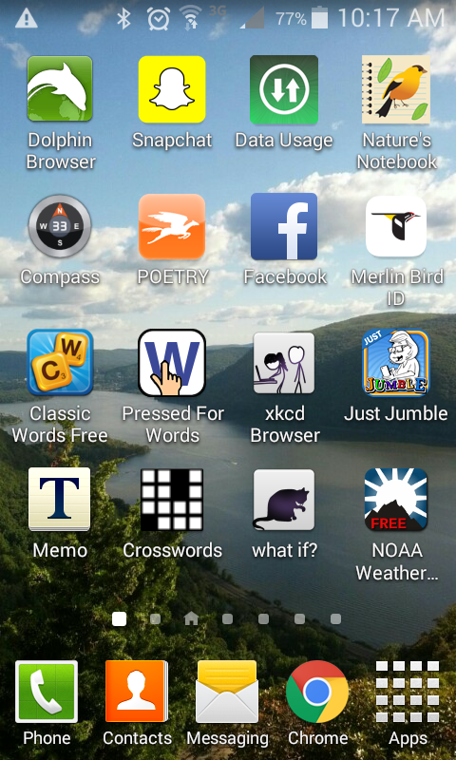
Mobile App
NPN Mobile App

Slide 18
Making Observations
As an observer, you’ll answer questions about the basic parts of a plant: leaves, flowers and fruit. You will watch as they emerge and develop. You’ll report on the stage of development of these structures including when they die and drop off the plant. What these structures look like varies from species to species. A packet with descriptions and pictures of what they look like at different stages is available on the NPN website and in a packet here.
You will often see the term "phenophase". It refers to the phase or stage in the life cycle of a plant. Examples of phenophases include newly emerging leaves, flower buds or open flowers.

Slide 19
Self-Training
Now that you are set up as an observer, you will want to get familiar with phenology, phenophases and what you will be seeing in the field.
Review the species profiles associated with the Fern Glen trail found in Nature's Notebook and in this packet.
Watch the webinars provided by USA-NPN found here (www.usanpn.org/nn/connect/Webinars2014).
Attend a training session (contact Vicky Kelly for dates & times).
Meet the observing community. Make plans with other observers to go out into the field with them. Learning from a peer in real time is the best training there is! Plus it is just really fun to observe with others.
If you are worried about your data at first, feel free to do a few practice rounds with your data sheets or the smart phone app and just don’t enter the observations into the USA-NPN site. When you are comfortable, you can enter your data. Know that you can go back and change entered data if the following week you realize you made a mistake!

Slide 20
Some Notes & Details About Observation Protocols
Each species has a specific phenophase protocol identified by USA-NPN. You can print out the phenophase descriptions from your observation deck or from the packet provided. If you use your mobile device, there is a little information button that will give you the specifics related to each species about what to observe.
We recommend that our observers make observations 1X per week. During the peak season, observing 2X a week will allow you the most chance to see the phenophase as it first shifts - which is the most valuable observation to make. Understanding that observers participate as their schedules allow however, most phenology observation programs utilize data collected 1-2X per week on average. As you will be making observations as part of a network, it is recommended that you talk to your fellow participants to try to spread out your observations so that someone is going almost every day if possible. Again, this is optimal, but not necessary for the program to be successful.
Some species will go through their entire life cycle quickly while others will take the entire observing season. For example, trout lily aka dogtooth violet, is a spring ephemeral that leafs out, flowers and fruits during the spring. By May, all traces of the plant have disappeared and you can stop making observations on this species.
Some species will go through their life cycle (leaf out, flower, fruit), but will keep their unfolded leaves for the entire season. For example, red maple will be done fruiting by May but will have green unfolded leaves through the summer. The leaves will then turn red or yellow in the fall. It is best to have an unbroken record through the phenophases, so you can keep marking “unfolded leaves” while you wait for the leaves to change color. In the fall, there will be a whole new set of fall phenophases to observe. As long as the plant has a phenophase to observe, even if it is repeat observations for long time (as in the case of “unfolded leaves” for red maple), please continue to observe this species.
After the leaves have fallen or died there will be a period of dormancy. During this period, you can stop making observations on this species. However, some of the them do begin their life cycle again in the latter part of the winter, so please begin observing again by March 31. One species on our phenology trail, American witchhazel, flowers in October-November.

Slide 21
Out on the Trail
You’re finally ready to head out to the Fern Glen to find the plants and get started. On the next pages, you’ll find a list of the plants, a map of where they are, followed by photos of the plants. In a separate packet and on the NPN website, you can find detailed descriptions of the phenophases of each of the plant species.
Use the list, the map and the photos to find all the plants. Look at the plants and note if you see leaves, flowers or fruit. Look at the Nature’s Notebook app or datasheets to see what kinds of questions you’ll be asked. But don’t enter data yet.

Slide 22
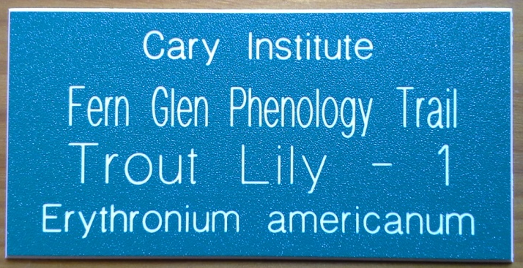
The plants as you will encounter them on the trail. Most species have 2 plants.
Red maple – 1
Bluebead – 1
Northern spicebush – 1
Red maple – 2
Red trillium – 1
Sharplobe hepatica – 1
Red trillium – 2
Jewelweed – 1
Trout lily – 1
Starflower – 1
Canada mayflower – 1
Pink lady’s slipper – 1
Starflower – 2
Canada mayflower – 2
American witch hazel – 2
Northern spicebush – 2
American witch hazel – 1
Trout lily – 2
Yellow lady’s slipper – 1
Note: Yellow lady’s slipper is not in NPN, must use datasheet
Each plant on the trail is marked with a green tag like this:

Slide 23
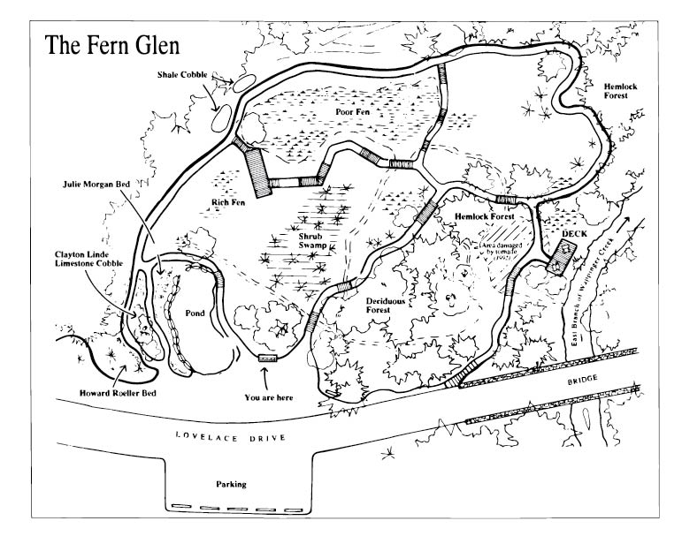
The Map
Canada Mayflower 1
Starflower 1
Pink Lady Slipper 1
Trout Lily 1
Skunk Cabbage 1
Skunk Cabbage 2
Red Trillium 2
Jewelweed 1
Yellow Lady Slipper 1
American
Witchhazel 2
Swamp Milkweed 1
Canada Mayflower 2
Starflower 2
Northern
Spicebush 3
Sharplobe
Hepatica 1
Red Trillium 1
Northern
Spicebush 2
Red
Maple 2
Red
Maple 1
Trout Lily 2
Northern
Spicebush 1
Bluebead 1
American
Witchhazel 1
The Map

Slide 24
Red maple
Acer rubrum

Slide 25
Bluebead Lily Clintonia borealis

Slide 26
Northern Spicebush Lindera benzoin

Slide 27
Red Trillium Trillium erectum

Slide 28
Sharp Lobed Hepatica Anemone acutiloba

Slide 29
Jewelweed Impatiens capensis

Slide 30
Trout Lily (aka Dogtooth Violet) Erythronium americanum

Slide 31
Canada Mayflower Maianthemum canadense

Slide 32
Starflower Trientalis borealis

Slide 33
American Witch Hazel Hamamelis virginiana

Slide 34
Pink Lady’s Slipper / Mocassin Flower Cyperpedium acaule

Slide 35
Yellow Lady’s Slipper Cypirpedium parviflorum

Slide 36
Collecting & Submitting Data
Now that you’ve found all the plants on the trail and have a feeling for the phenophases and the questions you’ll answer about them, you’re ready to collect and submit data to the NPN. You will do this using either the Nature’s Notebook smart phone app or datasheets for later data entry on the NPN website.

Slide 37
To collect data via the smart phone app, click on the Nature’s Notebook app

Slide 38
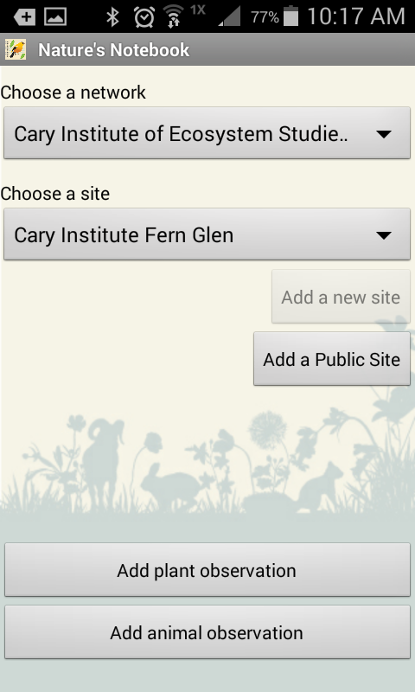
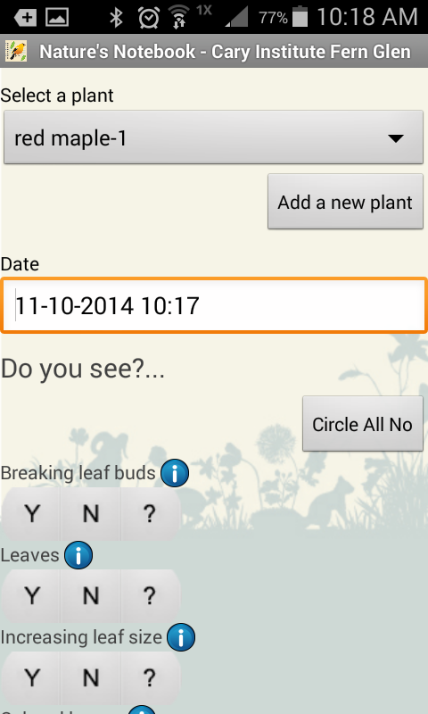
Select Cary Institute of Ecosystem Studies & Cary Institute Fern for network & site. Click on Add plant observation.
Choose the plant you are observing from the drop down menu under Select a plant

Slide 39
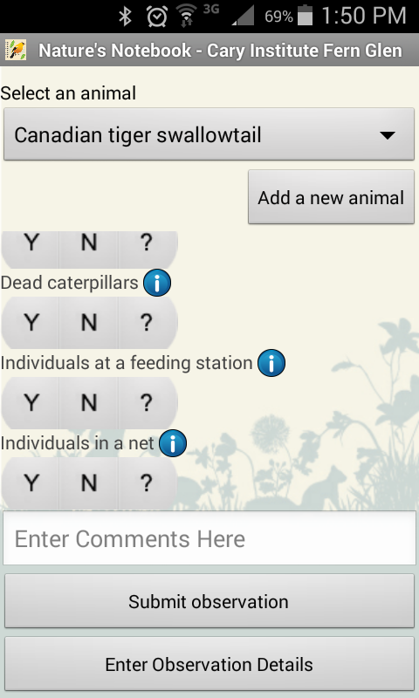
After answering all the Y N questions,
click Submit observation.
Choose another plant from the
drop down menu and continue.
Note, choose ? If you are unsure
if you see that pheonphase or not.
For a description of the
phenophase, click on the

Slide 40
Data entry from datasheets or editing data after submitting
If you collect data using datasheets, it is ideal for you to enter your data every week as you collect it. If you use the smart phone app, your data will be entered as you collect it.
To enter or edit data on the NPN website, log on to My Observation Deck on the NPN website.
Under Sites, choose Cary Institute of Ecosystem Studies and Cary Institute Fern Glen.
In the Enter Observations menu on the right, click on Enter Observation Data
You will see a series of menus and options. First make sure that the site you're entering data for is Cary Institute Fern Glen.
Next choose the dates for which you'd like to enter or edit data. There are 3 columns for different dates so that you can enter data for 3 dates at one time. Click on the calendar icon to choose the date for which you have data. If you would like to edit an observation, choose the date you collected the data.
Under the dates, you'll see drop down menus for the plants. Click on the double arrow to minimize or maximize the data for each plant.
Under each plant you'll see the same series of questions you had on your datasheet. Click on Y N or ? for each question. If you collected quantity data, choose the appropriate value.
At the top and bottom of the page is a very important SUBMIT OBSERVATIONS button. Be sure to click this before logging off.
Log off and you are done until the next time you enter data.

Slide 41
To enter observation data, log on to Nature’s Notebook
then My Observation Deck
Select Cary Institute Fern Glen & Enter Observations

Slide 42
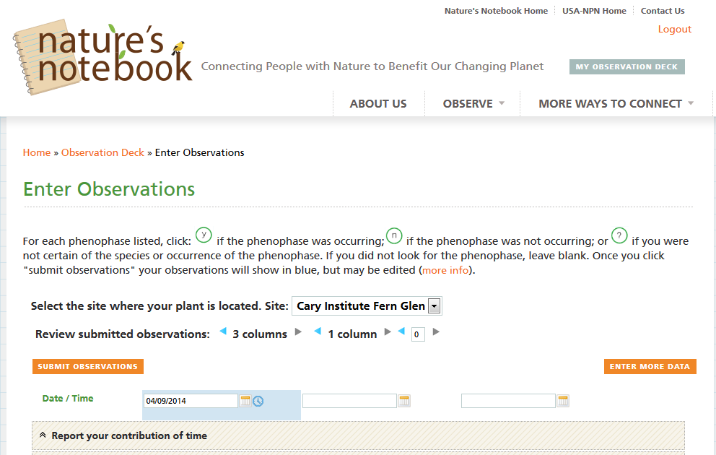
Select the date for which you want to enter data. To change the date, click on the calendar icon. You can enter or edit data for 3 different dates at a time.

Slide 43
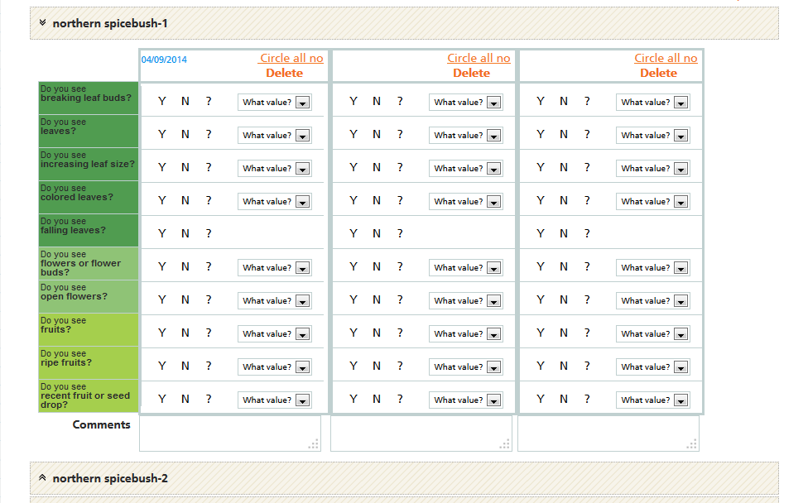
Select the plant for which you want to enter data. Note the up and down double arrows to the left of the plant name; this allows you to expand or contract the questions associated with that plant.

Slide 44
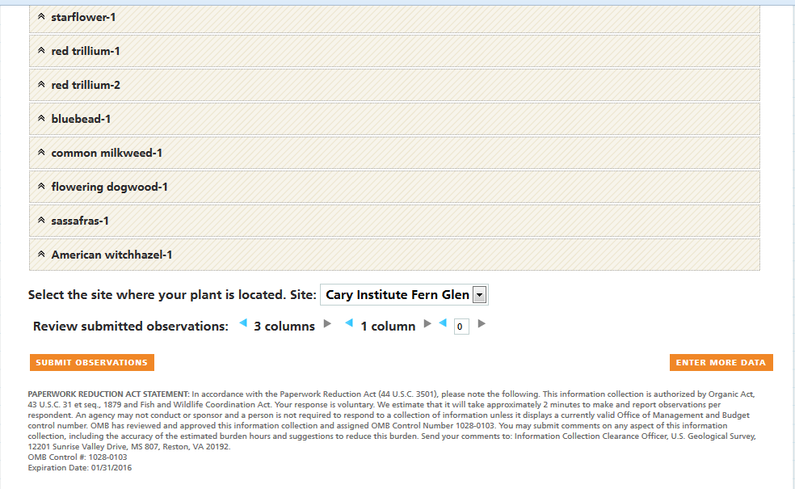
When you’re done entering data, click SUBMIT OBSERVATIONS

Slide 45
Have fun THANK YOU and don’t hesitate to contact Vicky Kelly if you have questions kellyv@caryinstitute.org or 845 677-7600 ext. 174
Resources:
Cary Institute of Ecosystem Studies www.caryinstitute.org
New York Phenology Project www.nyphenologyproject.org
USA National Phenology Network www.usanpn.org
USA NPN Nature's Notebook www.usanpn.org/natures_notebook

