Slide 1
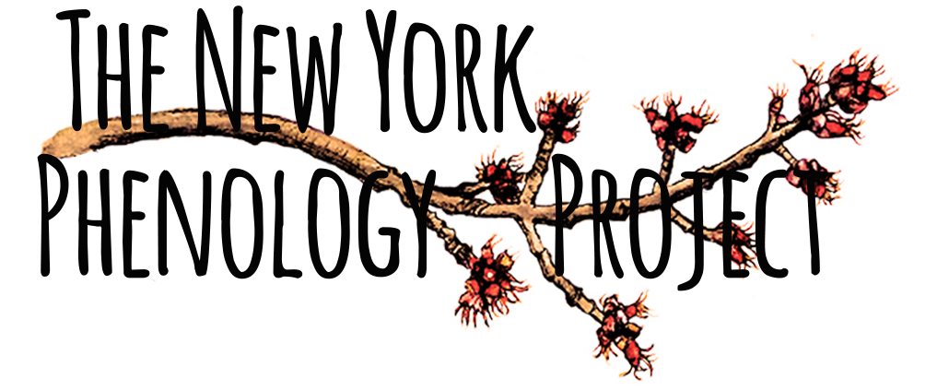

Organization Phenology Trail
Organization logo here
Common name: 16pt Genus Species: 16pt
Description: 11pt text
Habitats: 11pt text
Phenology highlights: 11pt text
Whole plant photo
Photo credit:
Species facts (make sure this highlights pollinator relationships first, then ethnobotanical information
… is pollinated by …
Pollinator plant photo
(if possible)
Photo credit:
Distribution map USDA
(Note: change date in map credit to download date for each map)
Why observe this species? 11pt text
Tips for observing this species: 11pt text
Map credit: USDA, NRCS. 2014. The PLANTS Database http://plants.usda.gov, 25 July 2014). National Plant Data Team, Greensboro, NC 27401-4901 USA
For more information about phenology and the New York Phenology Project (NYPP), please visit
the NYPP website (www.nyphenologyproject.org) and the USA-NPN website (www.usanpn.org).
Notes:
FRONT

Slide 2
Common Name 22pt (Genus species 22pt)
Note: leaf(??), flower and fruit phenophases are nested so you may need to record more than one phenophase in each group; for example, if you record Y for “open flowers” you should also record Y for “flowers or flower buds.”
Breaking leaf buds
Leaves
Photo credit
Photo credit
Increasing leaf size
Colored leaves
Photo credit
Photo credit
Flowers or flower buds
Open flowers
Photo credit
Photo credit
Fruits
Ripe fruits
Photo credit
Photo credit
Phenophases not pictured: Add missing phenophases for each species here

